Slide 1
Difficult circumstances, Teacher agency and Support
Amol Padwad
Ambedkar University Delhi India

Slide 3
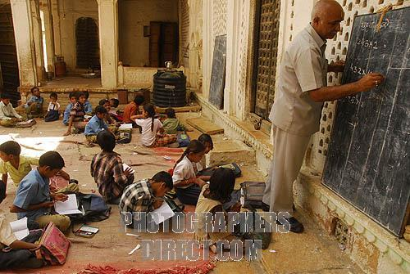

Slide 4
What difficult circumstances?
Two dimensions of DC - an objective reality and a mental construct
Teacher agency - (belief in one’s) capacity to do/ cause something
“a mental state, consisting of components such as beliefs, capabilities, and commitments” (Luck and d’Inverno, 1995:2)
Teacher agency significantly shaped by this belief in capacity and mental construct of DC
Therefore affective support is crucial in promoting teacher agency in coping with DC

Slide 5
Group support
Background - DC
English teacher clubs - genesis & journey
Affective support in ETCs
Sharing and caring
Collective ideas and solutions
Risk-taking and experimenting
Psychological security for these
Change of mindset and approach

Slide 6
A sample pair of quote
"Whenever I come across this problem [lack of motivation] I always try to know reasons behind it. I always find the same reason, i.e. our today's traditional methodology of teaching in which students remain passive.” (An ETC-member)
"[M]any students are not interested in learning in rural areas. Because their parents are not interested in giving [them] proper and regular education.” (A non-member)
(Padwad & Dixit, 2008)

Slide 7
Another pair of quotes
"Very large classes have become the unavoidable bitter reality of the present education system. Whether one likes it or not, one has to handle the situation in one way or the other.” (An ETC-member)
"Here teachers can't do anything [about prescribed textbooks] because this policy is already decided and planned by authorities.” (A non-member)
(Padwad & Dixit, 2008)

Slide 8
Thank you !

