Slide 1
Harry Kuchah Kuchah
Developing Teacher Agency and impact through TA Research:
The CAMELTA Research Group Initiative

Slide 2
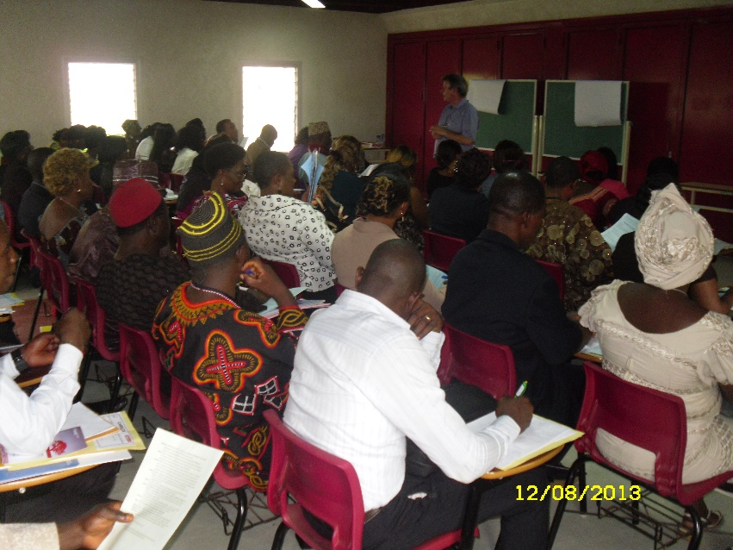
History of CAMELTA Research….
Deena Boraie
Christine Coombe
Richard Smith
Notes:
Key speakers at the Symposium included: Deena Boraie, The American University in Cairo, Egypt Christine Coombe, Dubai Men’s College, Dubai, UAE Richard Smith, University of Warwick, UK

Slide 3
Cameroon: Practical concerns…
General dissatisfaction with conditions of primary and secondary school teaching.
Perceived need to understand the nature and extent of difficulties, as a basis for proposing improvement.
Unlikelihood of most CAMELTA members being able to carry out individual research.
Notes:
Large classes…
Multi-grade classes especially in rural areas
Lack of prescribed textbooks and other resources
Multiple L1 influences
‘Francophones’ in English Medium schools.
Multiple pedagogic innovations
Multiple summative assessments
High stakes end-of-primary exams
A ‘deficit’ approach to INSET
Point 3: due to time and resource constraints as well as lack of research experience or training.
So the idea of a TA research, we thought, would help us in:
gathering a large amount of data if the association as a whole could be mobilized;
sharing of appropriate possible local solutions to problems if successes as well as problems could be shared;
collective development of research skills;
increased confidence of participants in their own ideas, serving as a preparatory basis for future projects, including more individual or small-group research.
resulting relative persuasiveness of the research to those in authority;
Our discussions following the symposium and during the conference in relation to the final point in particular, led Richard Smith to propose a change to the projected title of his last-day plenary talk, from ‘In difficult circumstances, the power of teacher-research’ to ‘In your circumstances, the potential of CAMELTA research’. Rather than providing guidance on how to carry out individual teacher-research as originally planned, he suggested in his plenary that CAMELTA could select some questions of general importance to the membership and then mobilize collectively to gather data from across the membership. Advantages of this could include

Slide 4
Possible advantages…
Gathering a large amount of data from within the association;
Sharing of appropriate possible local solutions to local problems;
Collective development of research skills;
Increased confidence of participants in their own ideas, serving as a preparatory basis for future projects, including more individual or small-group research;
(hopefully) resulting relative persuasiveness of the research to those in authority.
Notes:
This s

Slide 5
CAMELTA Research Priorities
How can you make students interact actively in English during English language lessons?
What strategies can be used to engage students in English lessons in a multilingual society?
How can teachers cope with the lack of textbooks on the part of learners?
How can teachers produce materials to bridge the gap created by inadequate materials?
What methods of teaching are appropriate in teaching a multi-grade class?
How can students in a large class be managed, motivated, taught and assessed effectively?
Student participation
Low resources
Large/MG teaching
Notes:
For example, questions 1 and 2 above were categorized as relating to ‘student participation and engagement’, questions 3 and 4 as ‘low resources’, and questions 5 and 6 as ‘large and multigrade classes’.

Slide 6
Questionnaire…
Please tell the story of a recent successful experience in your teaching - what was successful and what made it successful, do you think?
What are the major problems you face in your teaching situation - what is problematic and why?
Please describe anything you have done to address (some of) the problems in (2) above. Was this successful? Why / Why not?
Section C: Please write freely below if you have any comments about this questionnaire. (see Smith & Kuchah 2016)
(See: Smith & Kuchah 2016)

Slide 7
Feeding back and moving on…
ReSIG-CAMELTA analysis (Kuchah 2015)
Conference plenary presentation (2015)
Publication (Ekembe 2016)
Conference plenary presentation (2016)
Birth of CAMELTA Research Group

Slide 8
The CAMELTA Research Group…
Encouraging teachers to reflect on and interrogate their practices;
Coordinating teacher research based on autonomous and collaborative inquiry;
Testing new grounds in the classroom and reporting them to peers in monthly meetings;
Cultivating the spirit of Action Research and enhancing
Supporting Continuous professional development
Ekembe & Fonjong 2018: 29

Slide 9
Group Activities…
WhatsApp and face-to-face meetings
Identify common priority areas & ranking
Brainstorm: motivational practices
Brainstorm on investigating motivation
Article discussions (Eric?)
Reporting success stories
Group training workshops (AR)
Teacher mobility scheme
Notes:
a 5 step-agenda

Slide 10
Outcomes (achievements?)
Change in classroom practice
Notes:
Bawe and Fonjong sending Conference proposals for TESOL Africa 2019
Ekembe , E (2016) . Do ‘Resourceful’ Methodologies Really Work in ‘Under-resourced’ Contexts? In Murphy, A (ed.). New Developments in Foreign Language Learning. NY: NOVA Science Pub.
Ekembe, E & Fonjong, S (2018) Teacher Association Research for Professional Development in Cameroon. ELT Research, 33
Ekembe , E (forthcoming) Constructing English Language Teachers’ Identities in ‘Low-resourced’ contexts. Syllabus

Slide 11
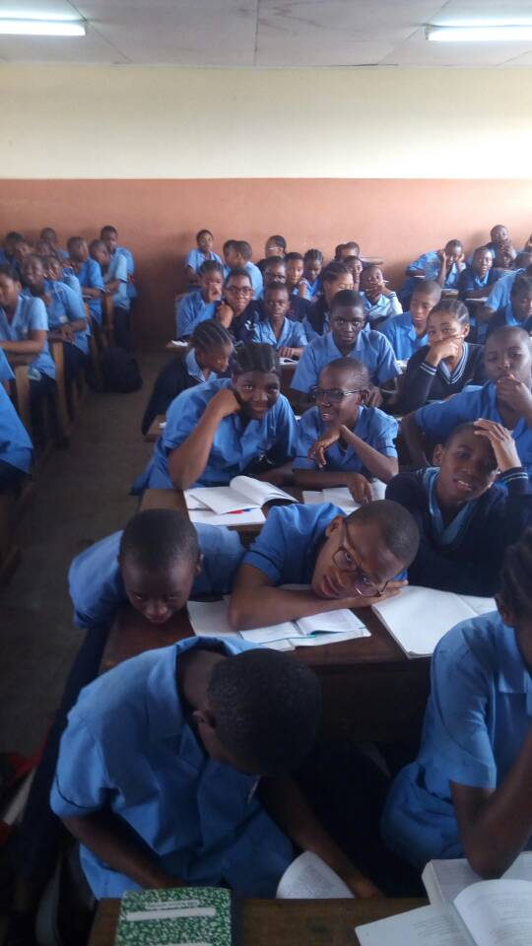
From teacher fronted teaching…
Notes:
Traditional Practices…

Slide 12
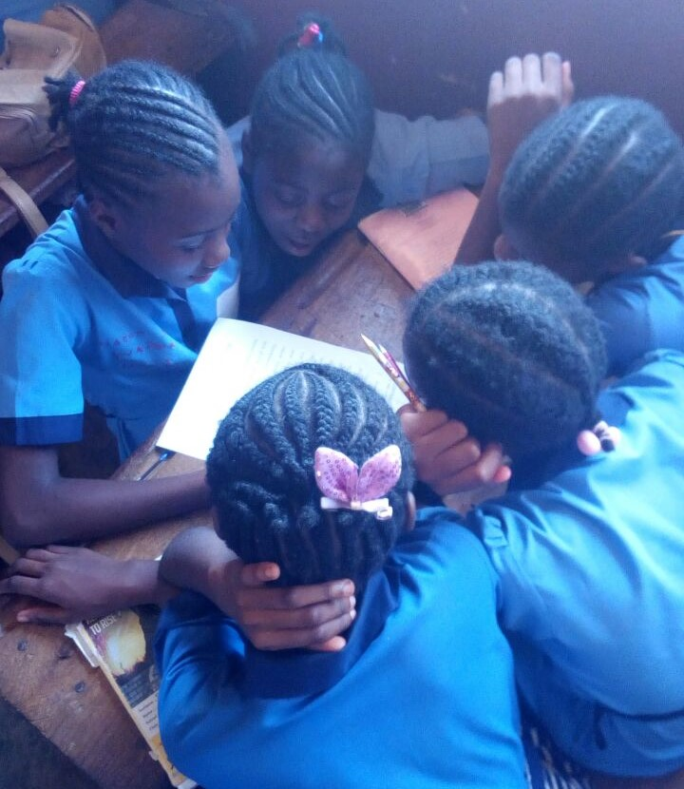
…to student-led projects
Notes:
Protecting the environment

Slide 13
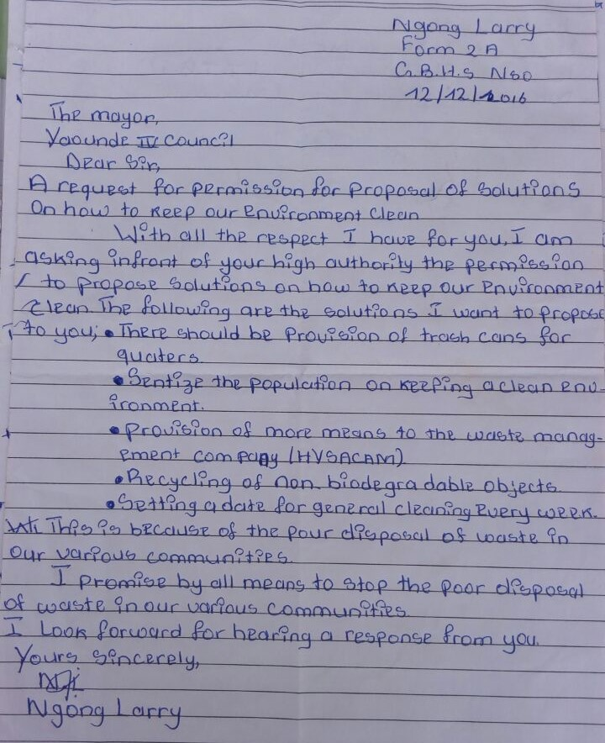

Slide 14
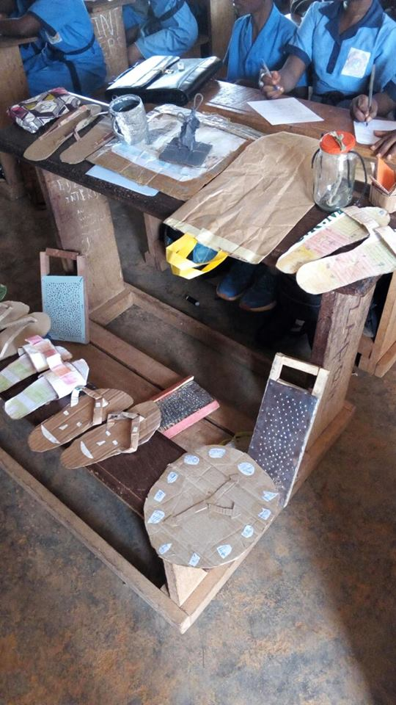
Notes:
Outcomes 1:Fading Classical Orientation to Learning

Slide 15
Outcomes (achievements?)
Change in classroom practice
Improved Self-confidence >>> local & international conference participation
Publications in newsletters and book chapters
Involvement in Pre-SETT
Supporting transition from PreSETT to INSETT
Sync/partnerships with MoE and College of Education
Organisation of ‘international’ seminar at CoE/GISIG
Notes:
Bawe and Fonjong sending Conference proposals for TESOL Africa 2019
Ekembe , E (2016) . Do ‘Resourceful’ Methodologies Really Work in ‘Under-resourced’ Contexts? In Murphy, A (ed.). New Developments in Foreign Language Learning. NY: NOVA Science Pub.
Ekembe, E & Fonjong, S (2018) Teacher Association Research for Professional Development in Cameroon. ELT Research, 33
Ekembe , E (forthcoming) Constructing English Language Teachers’ Identities in ‘Low-resourced’ contexts. Syllabus
Application (Demo lessons at ENS Yaounde)
Learning/more training (Reading Articles, Workshops/presentations- Peggy kang, Scott Thornbury, Joy Egbert, Lauren Nicole, Harry kuchah Kuchah,)
Engagement (joint events with schools of education-Prof Njika Prof Nkemleke, PI, and Pre-service teachers, American Peace corps)

Slide 16
Thank you !

